Slide 1
Trauma Injury Report
Han Wang
12/03/2022

Slide 2
Data Source and Structure
Five-year list of all trauma registry cases
Sample size = 11147
Gender:
Female (N= 5011): 44.95%;
Male (N= 11147): 55.05%.
Age ranges from 0 to 108 years
Age Groups:
Five-year age groups
Stages:
Pediatric (N=1272): 0 to 14 years
Adult (N=4792): 15 to 64 years
Geriatric (N=5083): 65+ years
Notes:
A five-year list of all trauma cases was retrieved from trauma registry of Stony Brook University Hospital. The purpose of the analysis was to explore relationship between the injury incident and trauma-related factors. 11147 observations was included for data analysis. 44.95% of observations were female, and 55.05% of observations were male. Age ranged from 0 to 108 years. Age was categorized as five-year age groups and three stages, including pediatric, adult, and geriatric. Please note that the data structure has some limitations. 45.6% of data were comprised of geriatric group. Therefore, imbalance dataset introduces the limitation that the classes are not represented equally.

Slide 3
Mechanism of Injury
Assault
Burn
Drowning
Fall (All Fall Categories)
Gunshot/Stabbing (GSW/STAB)
Hanging
Machinery
Motor Vehicle Crash (MVC)
Motorcycle Crash (MCC)
Other (Diving, Foreign Body, Found Down, Inhalation, and Jump/Push)
Other Transport (Bicycle/Boat/Plane Crash)
Pedal
Sports
Struck/Overexertion
Notes:
All trauma registry cases were categorized by mechanism of injury, which includes assault, burn, drowning, fall, gunshot/stabbing, hanging, machinery, motor vehicle crash, motorcycle crash, other (diving, foreign body, found down, inhalation, and jump/push), other transport (bicycle/boat/plane crash), pedal, sports, and stuck/overexertion.

Slide 4
Overview of Injury Trend by Mechanism of Injury
Notes:
First, let’s look at the injury trend by mechanism of injury in general.

Slide 5
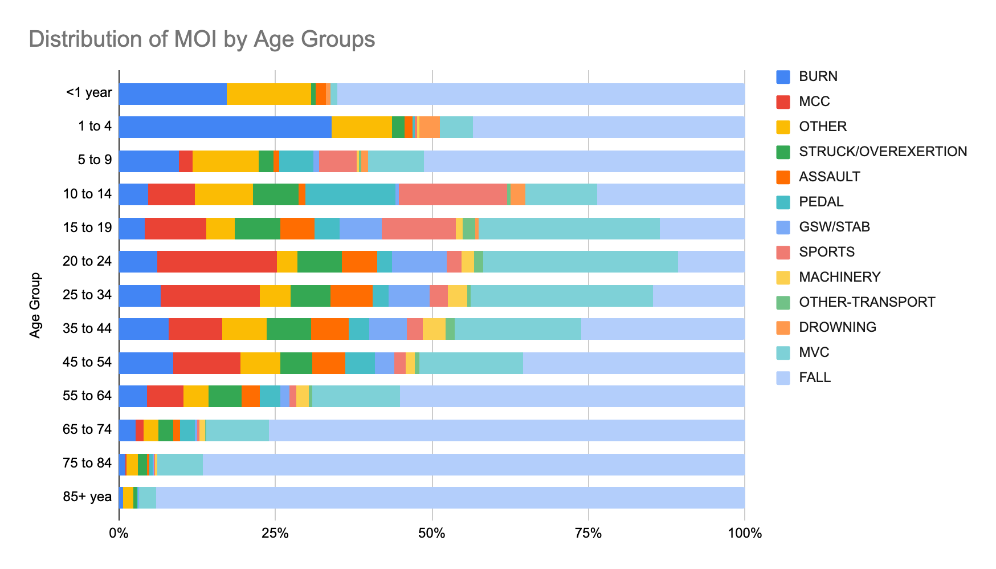
Notes:
This bar chart shows the overall distribution of mechanism of injury by age groups. Most trauma cases in the dataset are fall, motor vehicle crash, and other.

Slide 6
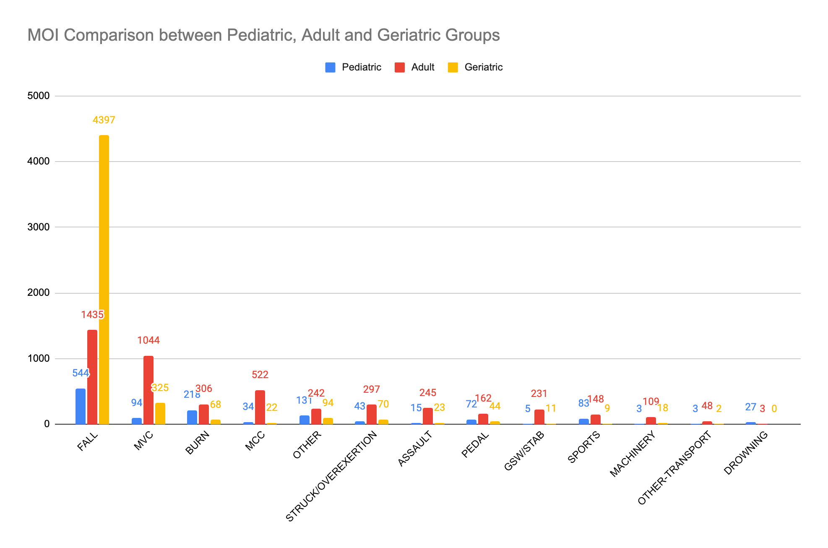
Notes:
Among people aged over 65, fall is the most common cause of injury.

Slide 7
Time Series Analysis

Slide 8
Overview of Injury Trend by Mechanism of Injury

Slide 9
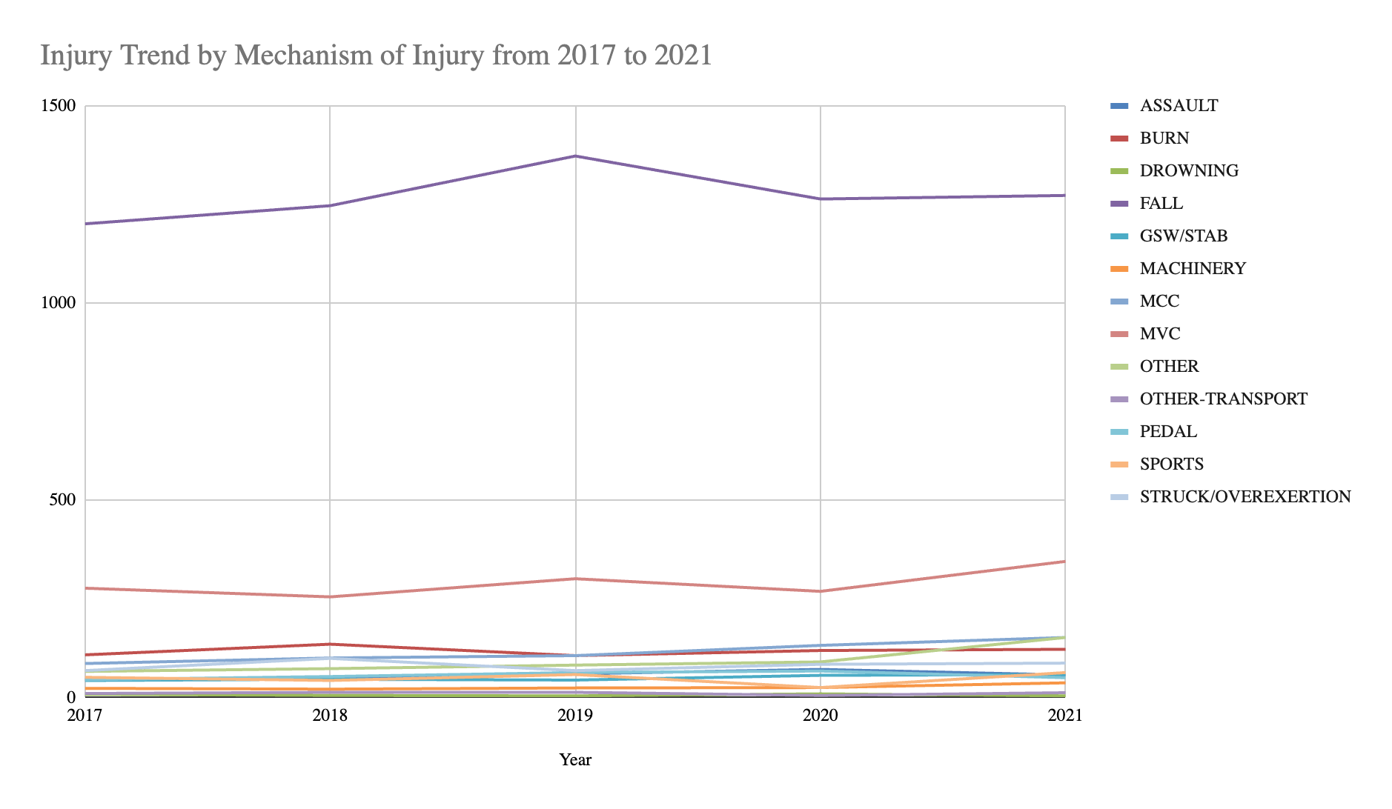
Notes:
This line chart shows the overall trend line from 2017 to 2021. Overall, all trauma cases are moving up.

Slide 10
Compare Fall Injury Trend between Geriatric Group and All Age Groups

Slide 11
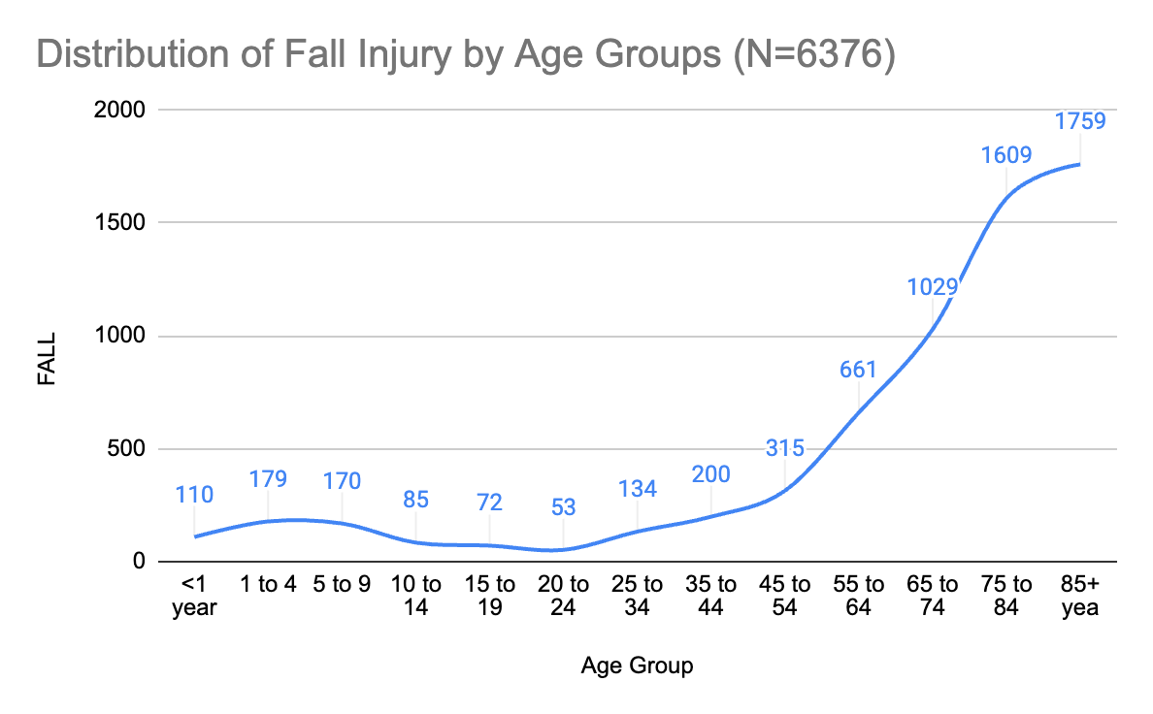

Slide 12
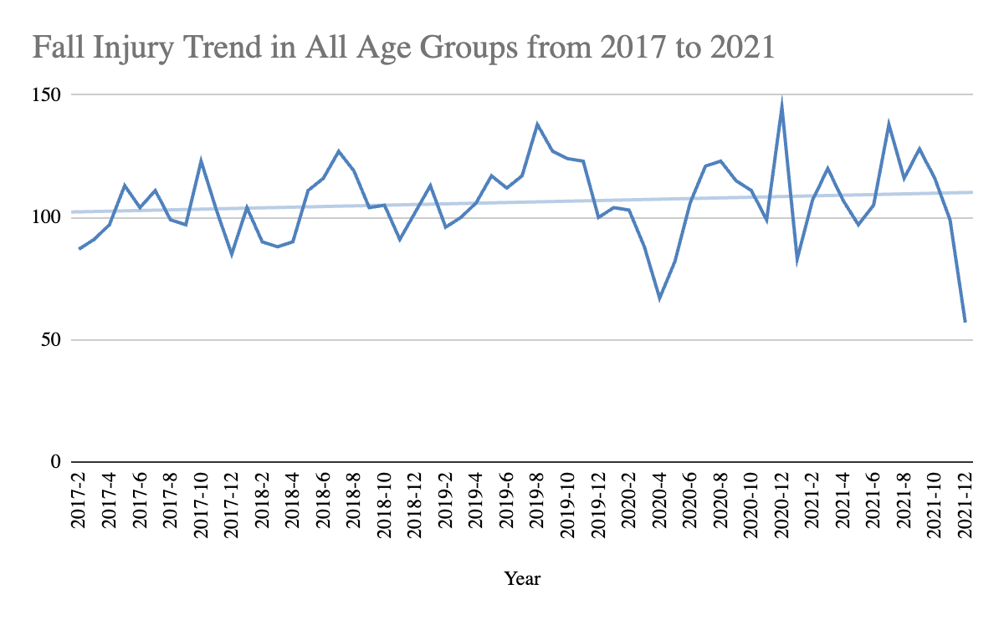

Slide 13
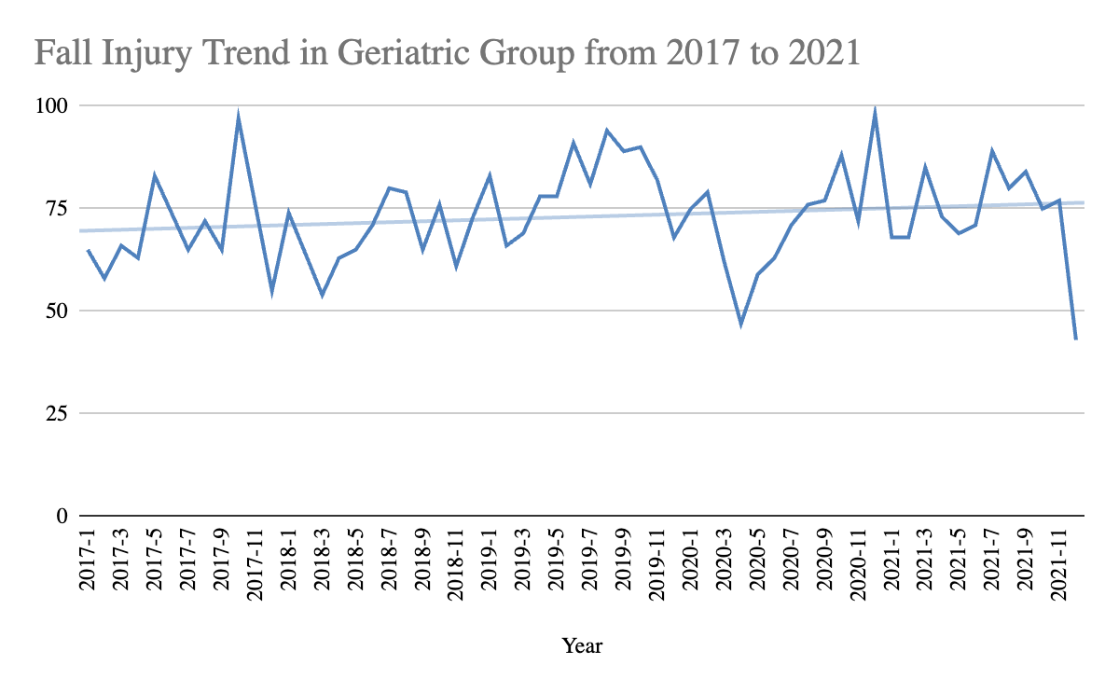

Slide 14
Compare MVC Injury Trend between Adult Group and All Age Groups

Slide 15
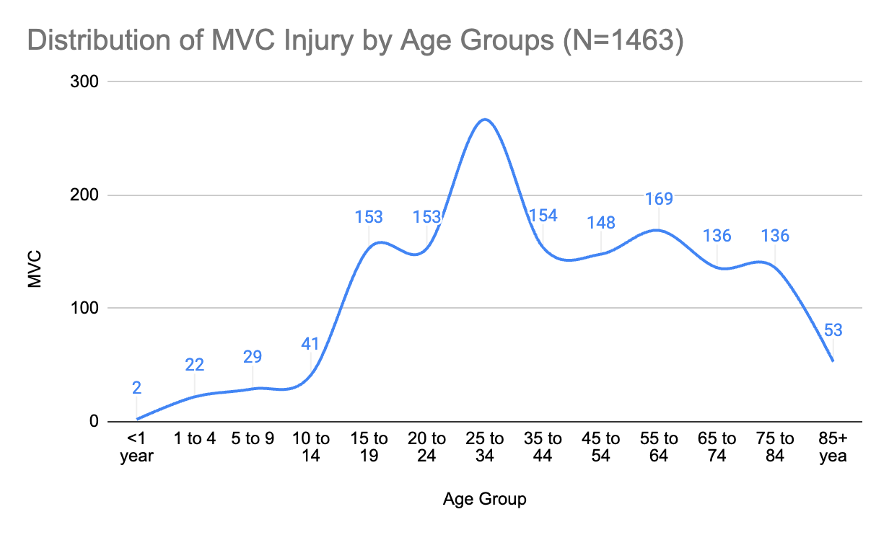

Slide 16
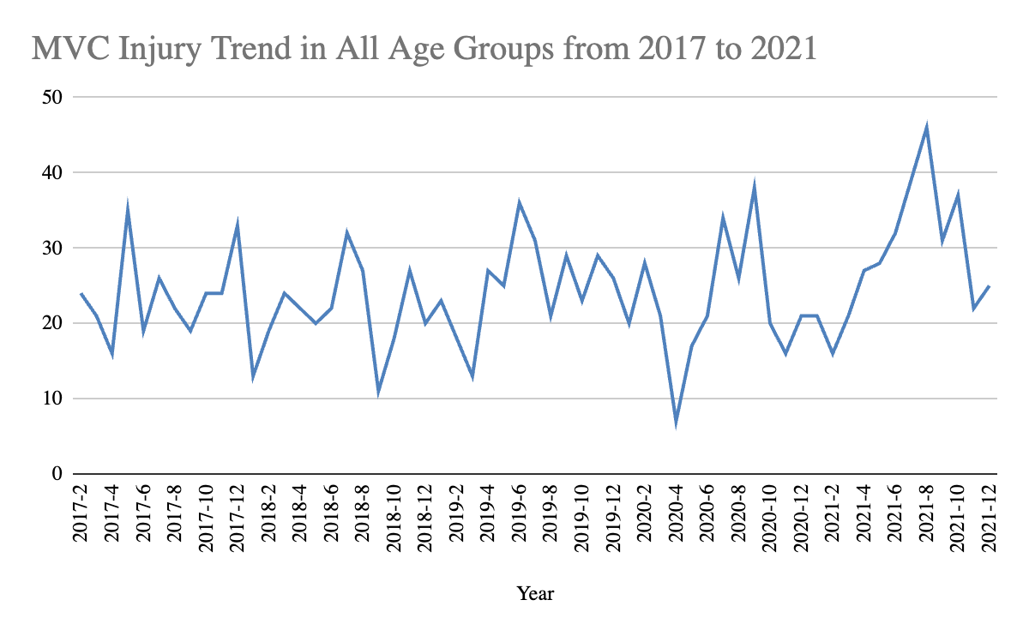

Slide 17
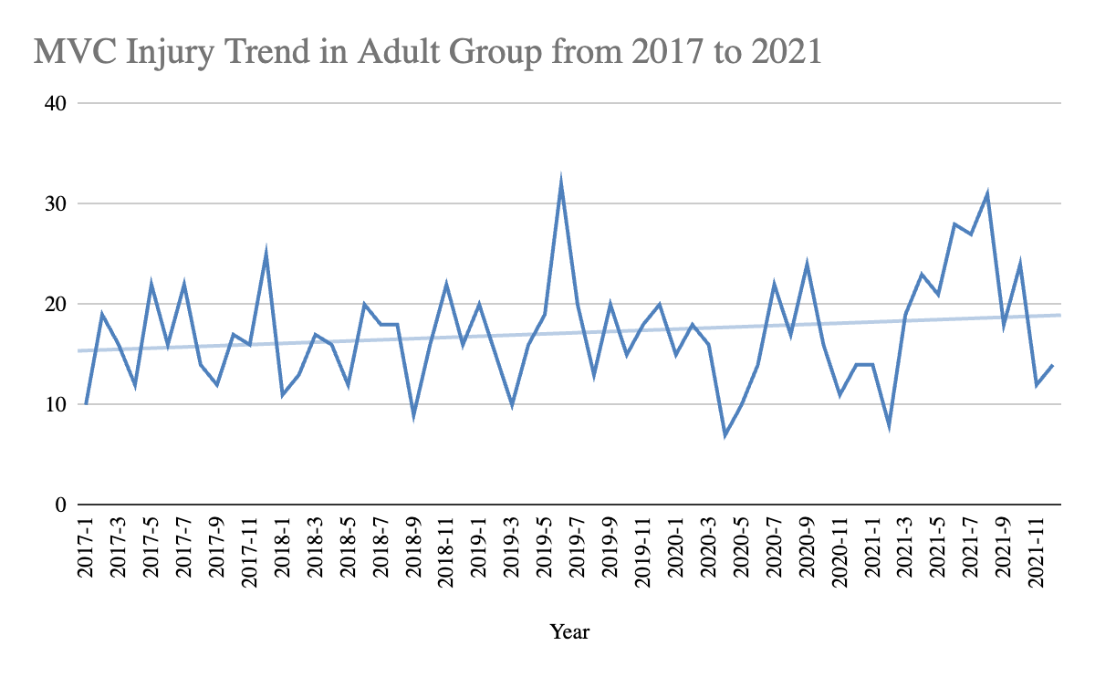

Slide 18
Compare Injury Trend between Intentional and Unintentional Injury
Notes:
Now, let’s look at the difference of injury trend between intentional and unintentional injury.

Slide 19
Compare Injury Trend between Intentional and Unintentional Injury
Intentional Injury (N=530):
Assault
Gunshot/Stabbing (GSW/STAB)
Unintentional Injury (N=10150):
Burn
Drowning
Fall
Machinery
Motor Vehicle Crash (MVC)
Motorcycle Crash (MCC)
Pedal
Sports
Struck/Overexertion
Notes:
In order to understand the association between the , we compared intentional and unintentional injury trend. Intentional injuries are injuries occur with purposeful intent, which include assault, gunshot, and stabbing. Unintentional injuries are injuries occur without purposeful intent, which include burn, drowning, fall, machinery, motor vehicle crash, motorcycle crash, pedal, sports, and struck/overexertion.

Slide 20
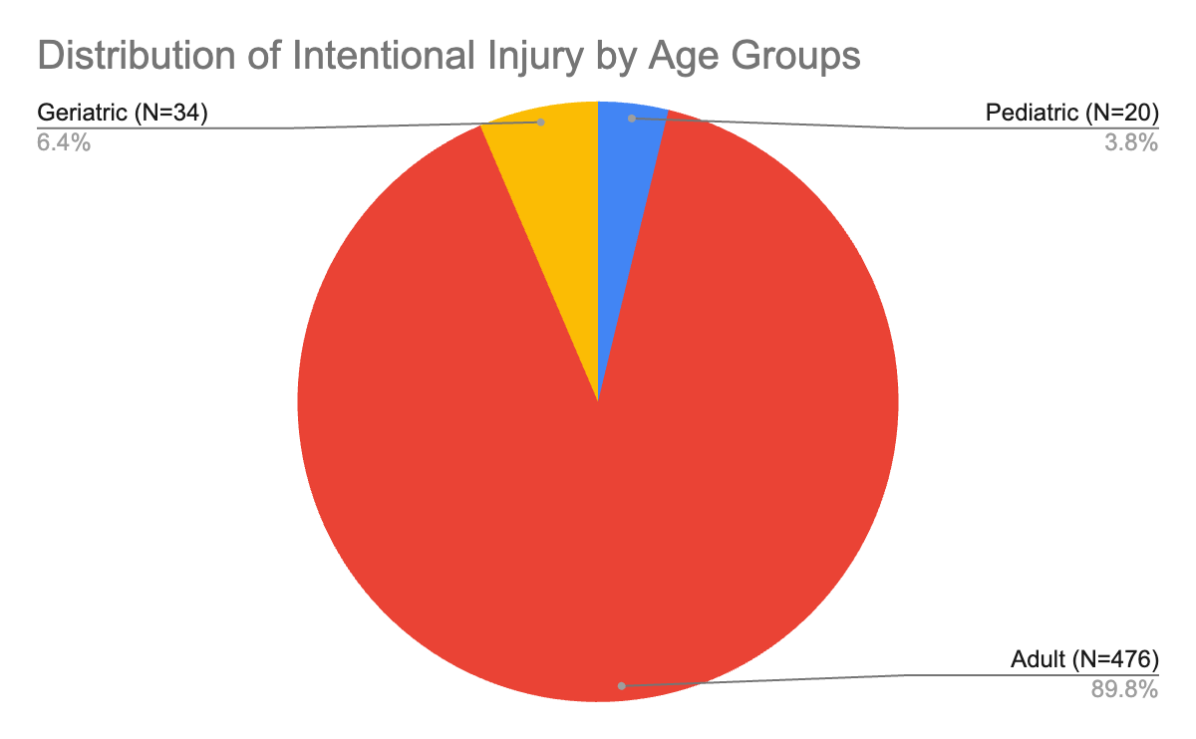
Notes:
This pie chart shows the distribution of intentional injury by three age groups over 5-year period. Intentional injuries occur frequently in adult group, which comprises 89.8% of injury incident. 10.2% of intentional injuries occurs in the pediatric and geriatric group.

Slide 21
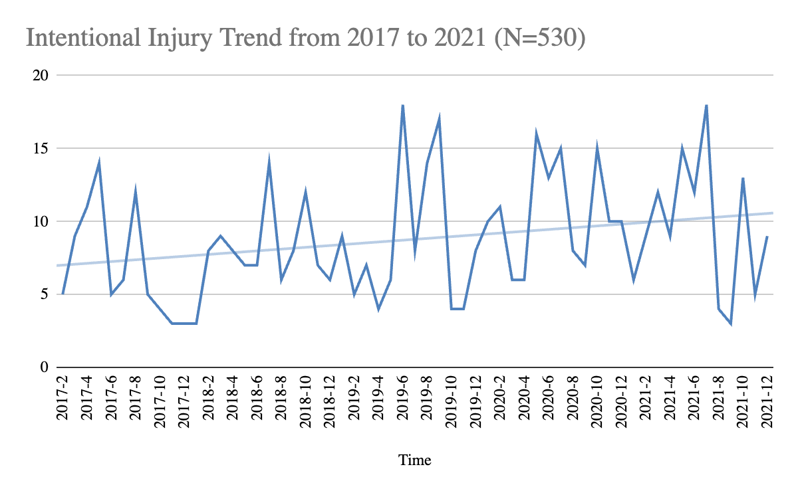
Notes:
From the time series perspective, the overall trend for intentional injury incident is moving up over 5 years. The intentional injury trend didn’t display any seasonal trend, but it’s important to note that intentional injury requires attentions all time throughout the year.

Slide 22
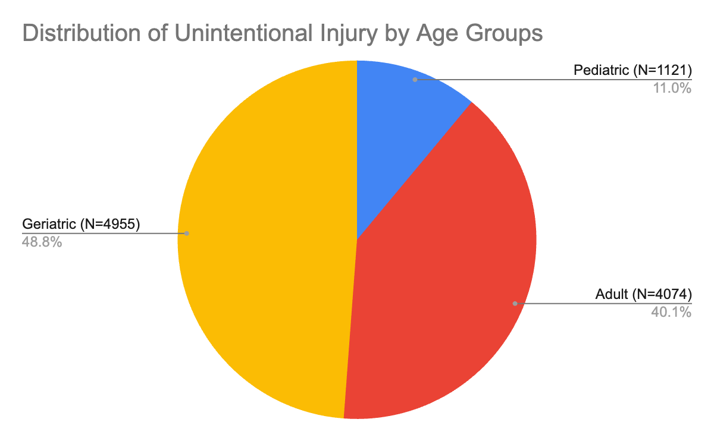
Notes:
This pie chart shows the distribution of unintentional injury by three age groups over 5-year period. Unintentional injuries occur frequently in adult and geriatic groups, which comprises 88.9% of injury incident. 11% of unintentional injuries occurs in the pediatric group.

Slide 23
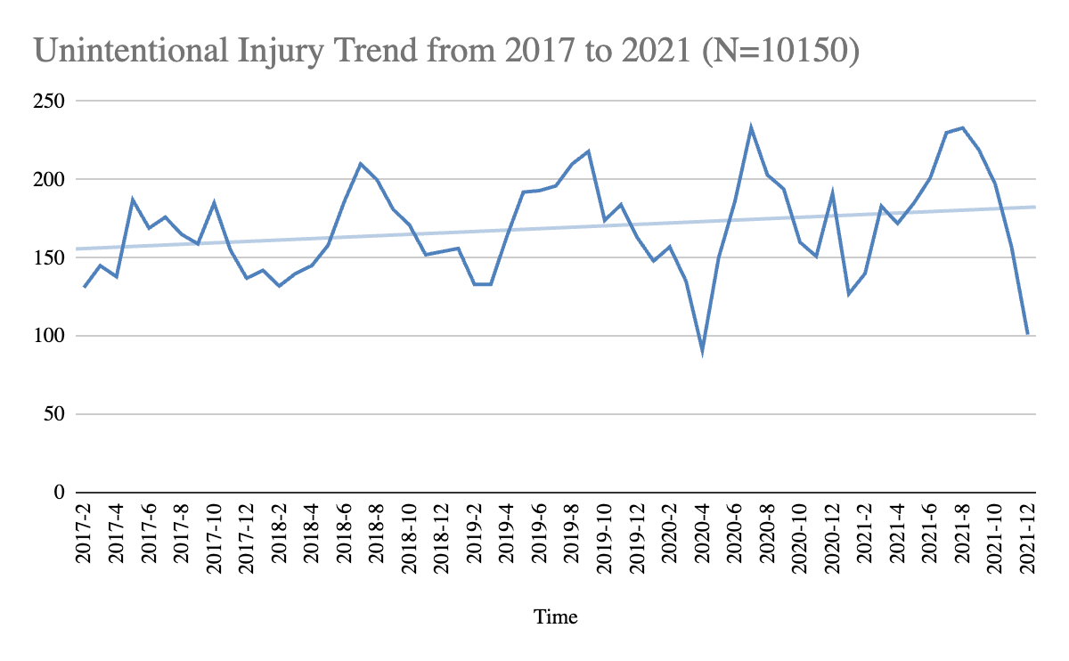
Notes:
From the time series perspective, the overall trend for unintentional injury incident is moving up over 5 years. The unintentional injury displays seasonal trend with peaks in summer and dips in spring and winter. Again, most trauma cases in the dataset are fall and motor vehicle crash, so it may not accurately reflect seasonal trend of unintentional injury in general.

Slide 24
Spatial Analysis

Slide 25
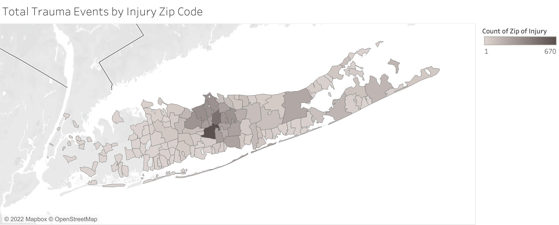

Slide 26
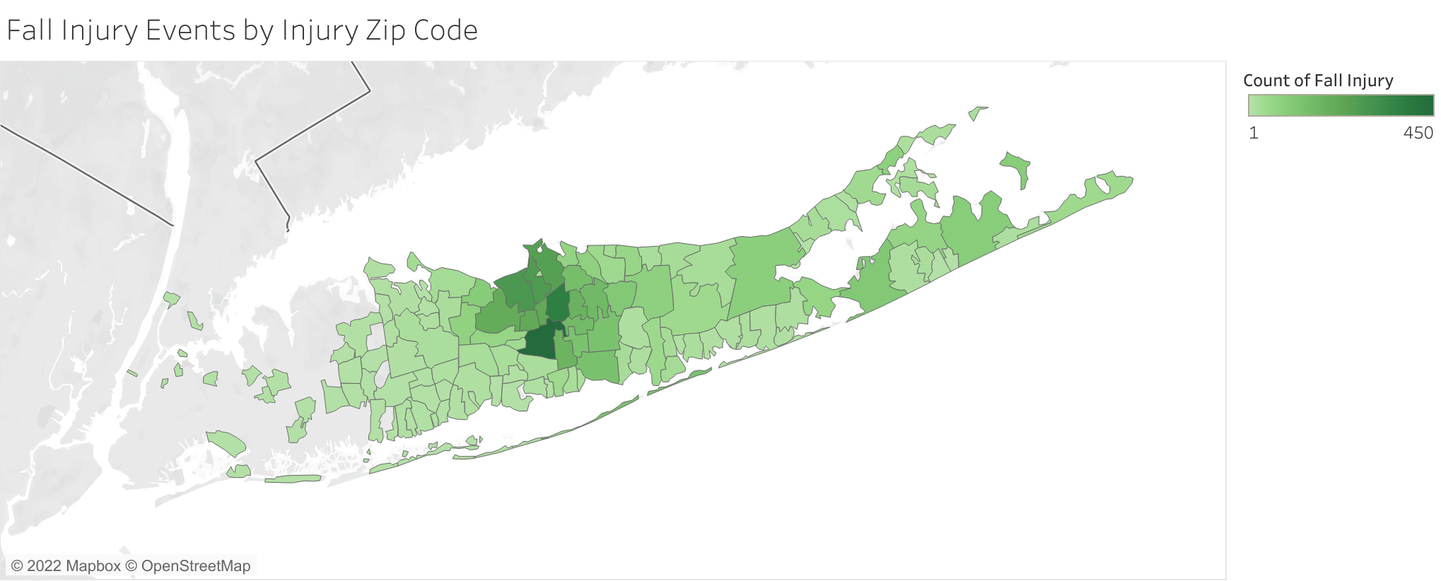

Slide 27
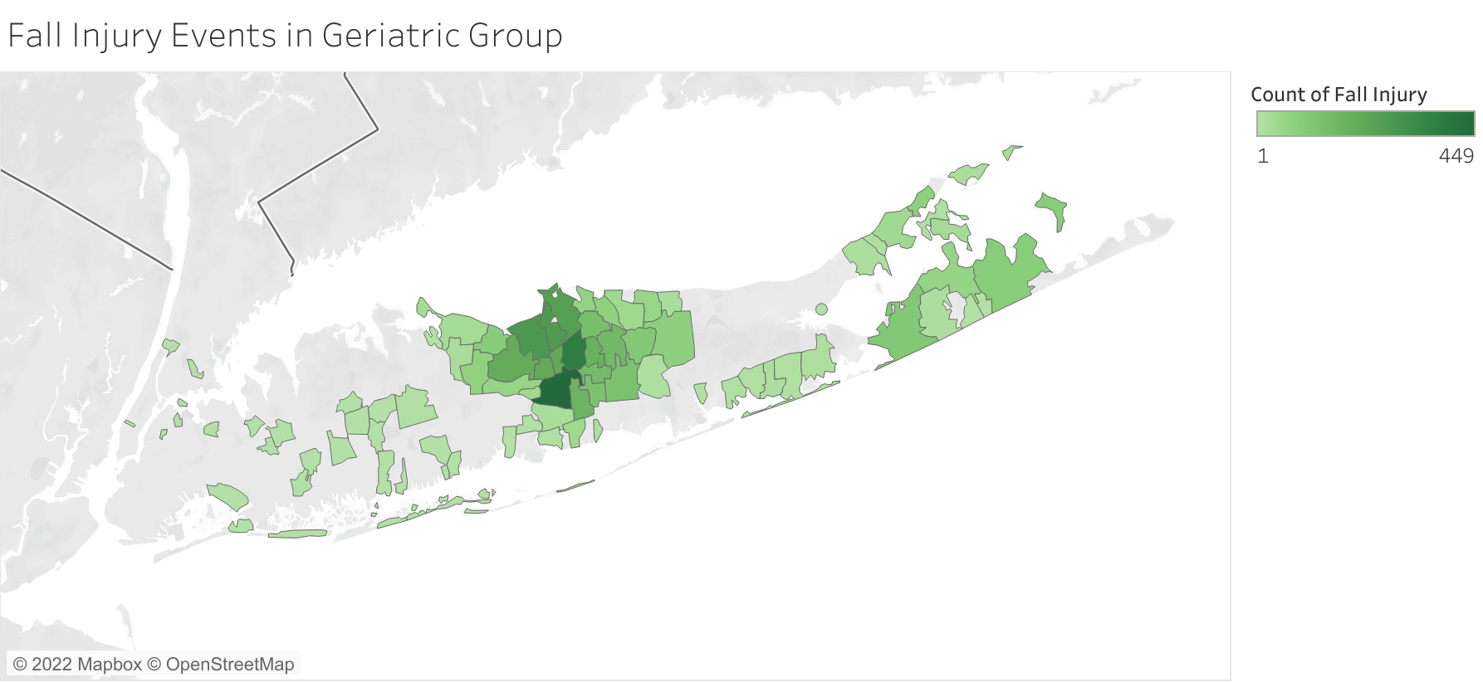

Slide 28
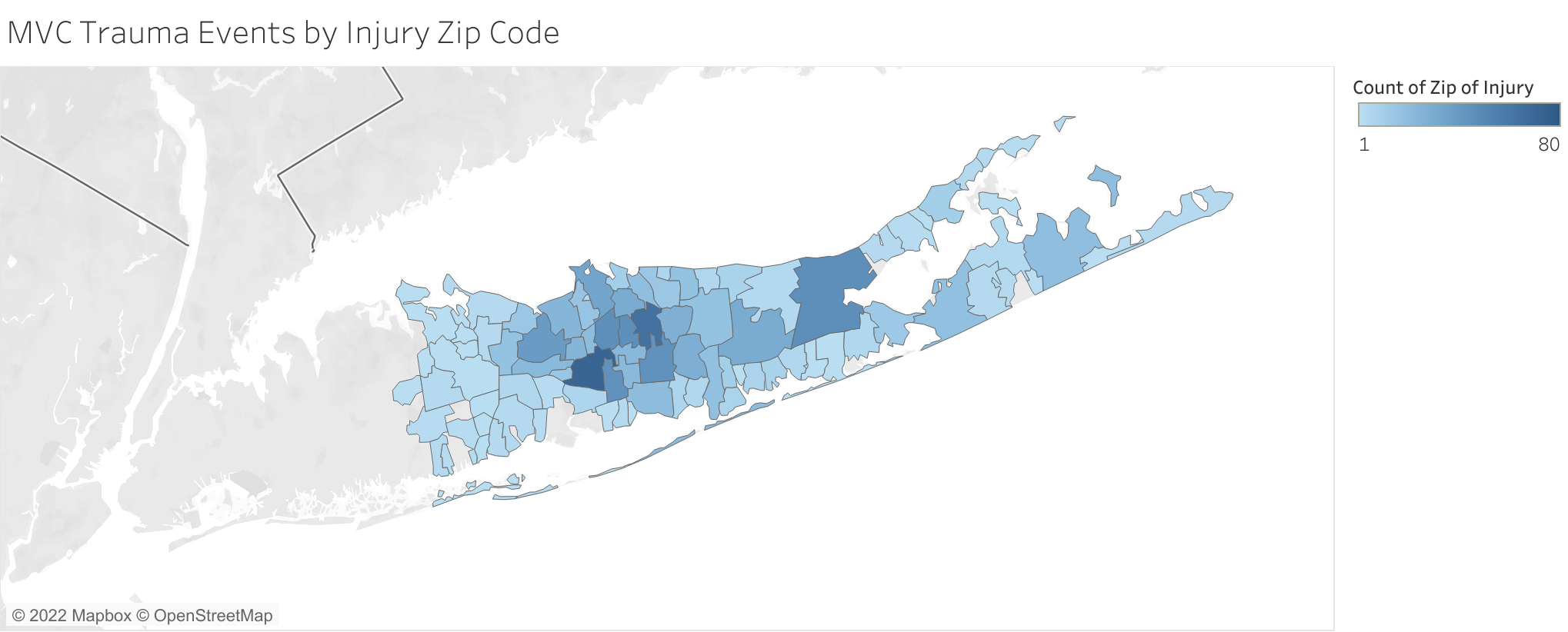

Slide 29
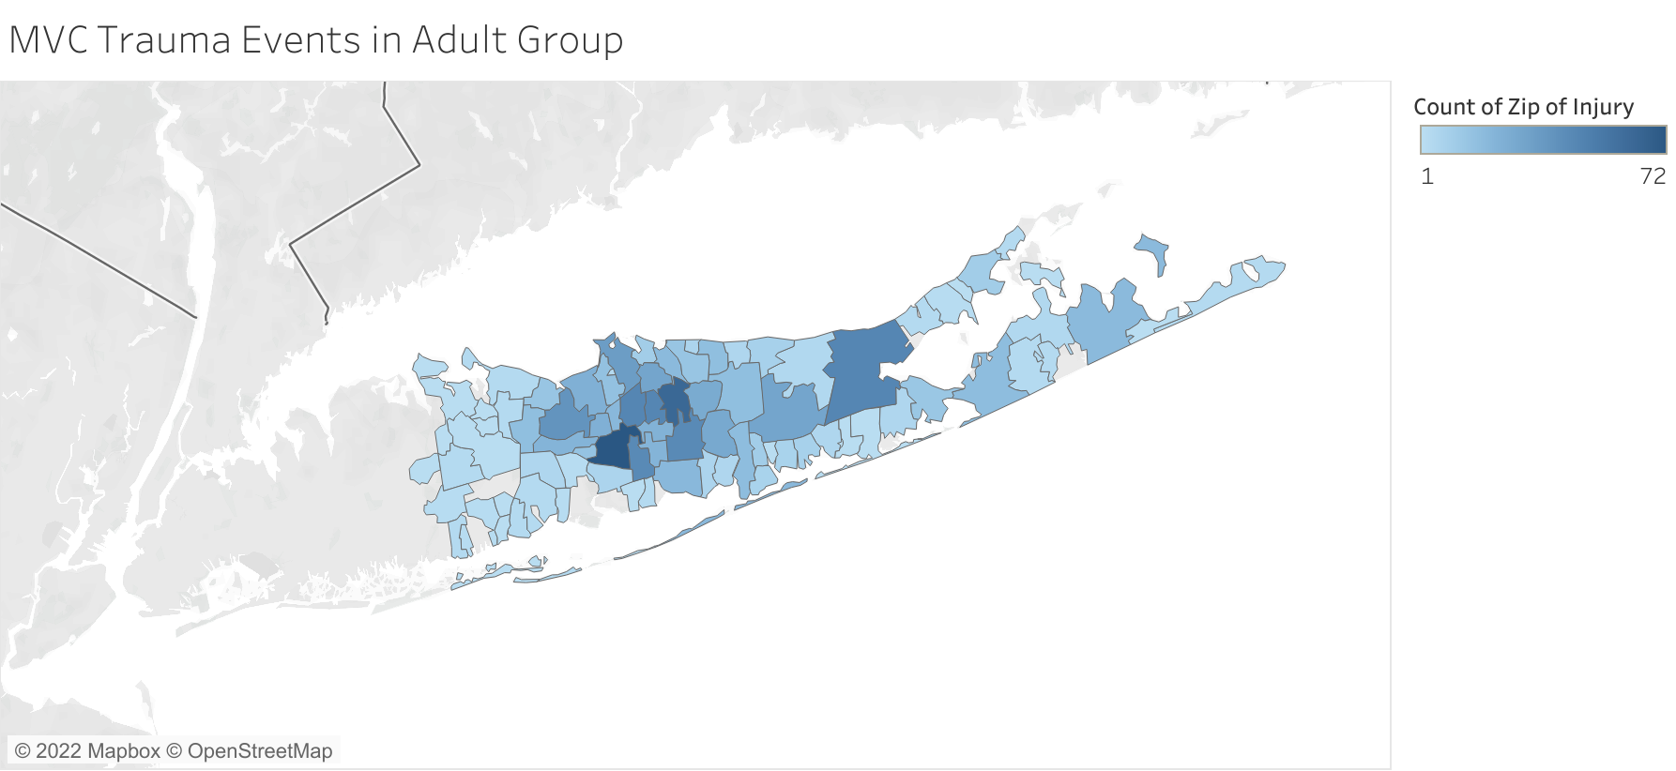

Slide 30
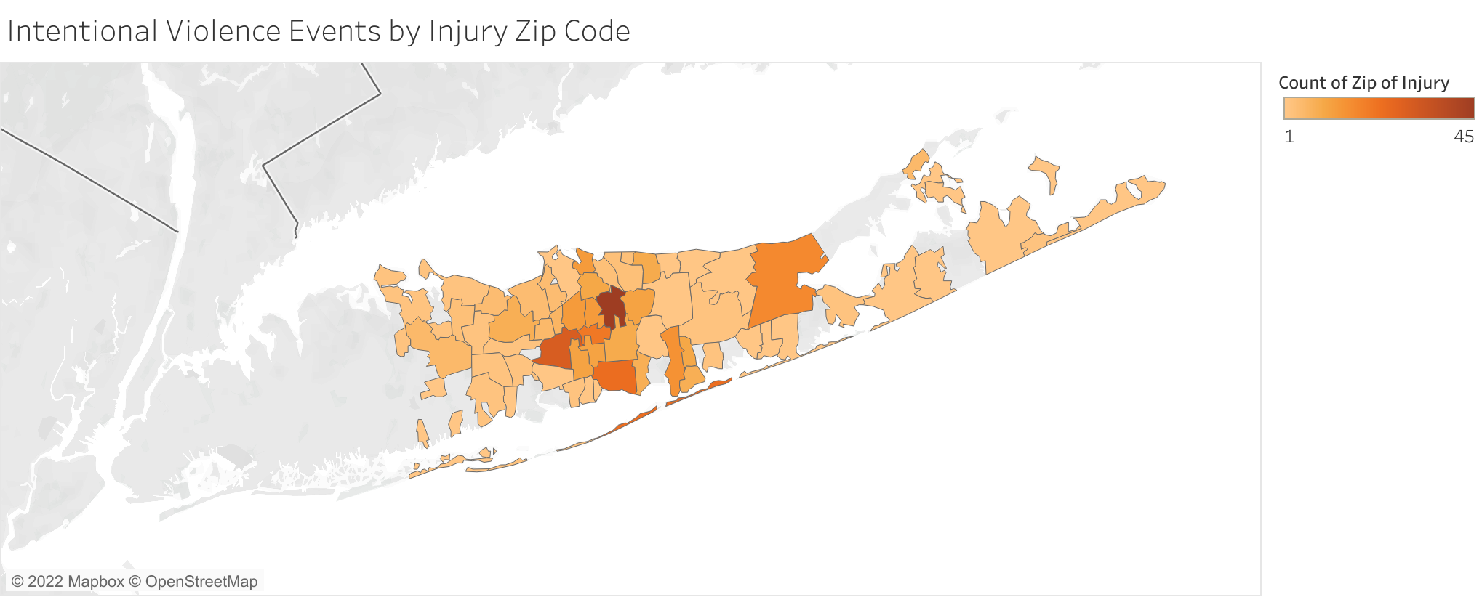

Slide 31
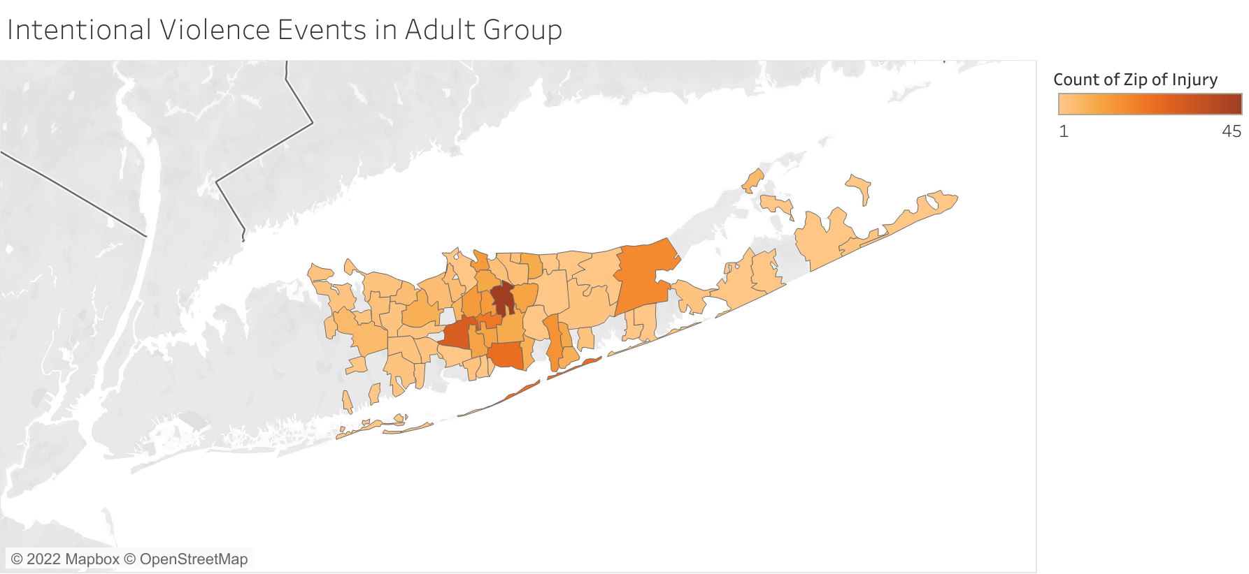

Slide 32
Strengths and Weaknesses
Strengths:
Understand the relationship between the injury incident and trauma-related factors.
Provide evidences to improve the current practice
Weaknesses:
Imbalanced dataset: Uneven distribution of observations.
The classes are not represented equally.
Some mechanism of injury are not large enough to be representative.
Notes:
This data analysis report has both strengths and weaknesses. Trauma injury trend helps to understand the relationship between the injury incident and trauma-related factors, which provide evidences to improve the current practice. The data analysis has some limitations. The dataset was imbalance because observations were uneven distributed. The classes are not represented equally, and some mechanism of injury are not large enough to be representative. Due to the limitation of data structure, it will not be an accurate representation of the population.

Slide 33
Conclusions and Recommendations for Future Research
The data analysis report present five-year trauma injury trend.
Evidence-based practice of trauma and critical care.
The study can be extended by including data from 2022 to compare the influence of pre/post COVID on trauma injury trend.
Future research should focus on how to strengthen collaborations between departments to provide quality services to the community.
Notes:
The data analysis report present five-year trend of trauma injury. Findings will support evidence-based practice of trauma and critical care. The study can be extended by including data from 2022 to compare the influence of pre/post COVID on trauma injury trend. Future research should focus on how to strengthen collaborations between departments to provide quality services to the community. Thank you so much for listening. Please feel free to reach out with any questions or suggestions.

